Slide 1
Learning Objective
I will be able to define sequences and arithmetic sequence given a rule.
Success Criteria
At the end of the lesson, I will be able to:
define a sequence and sequence notation using subscripts;
define recursion as a process;
perform basic operations with sequences; and
define an arithmetic sequence recursively and in terms of a common difference;
list terms of an arithmetic sequence given a rule;
write the recursive rule for an arithmetic sequence given terms;
derive the general (explicit) rule for an arithmetic sequence and make the connection to linear relationships;
find the nth term of an arithmetic sequence;
given two terms of an arithmetic sequence, find the common difference, first term and hence rules; and
verify whether a given value is part of an arithmetic sequence.

Slide 2
Let’s investigate the following sets of numbers
Skill Development
{3, 6, 9, 12, … , 21, 24, …}
{2, 4, 6, 8, 20, 22, 24, 26}
{1, 1, 2, 3, 5, 8, 13, …}
{1, 2, 4, 8, 16, 32 …}
{10, 5, 0, -5, -10, -15, …}
Add 3 to the previous number
No pattern
Fibonacci sequence
Double the previous number
Subtract 5 to the previous number

Slide 3
Sequence
Concept Development
A sequence is an ordered list with a pattern.
Example:
{3, 6, 9, 12, … , 21, 24, …}
In this sequence, we can describe it as
Start with the number 3 and add three
Each number of the sequence is referred as a term of the sequence.

Slide 4
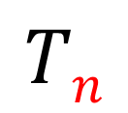
Concept Development
$$Tn$$
Placement of the term in the sequence
$T1, T2, T3, T4, … T7, T8, …$
{T_{n}} = {3, 6, 9, 12, … , 21, 24, …}
Pattern continues but terms has been skipped
Pattern continues on forever
… is called ellipsis

Slide 5
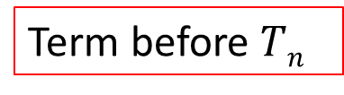
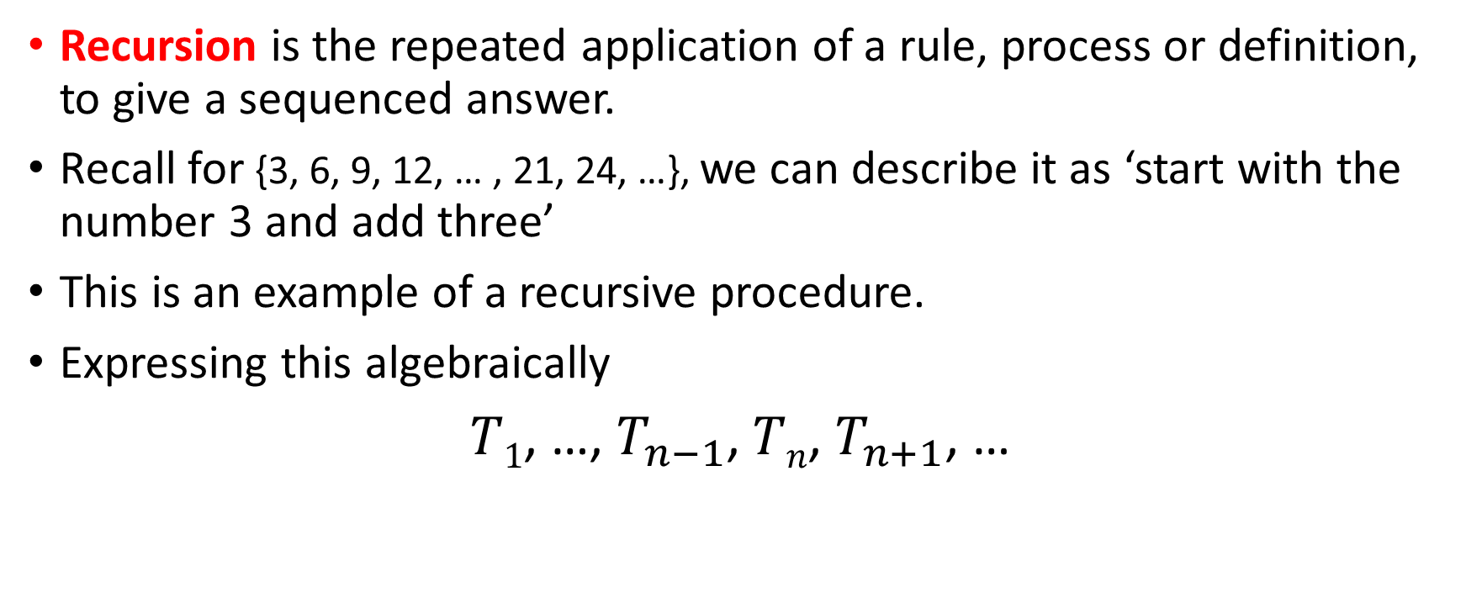
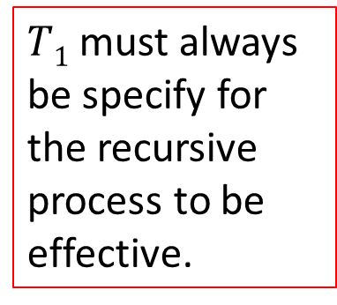
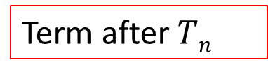
Recursive Process
Concept Development
Recursion is the repeated application of a rule, process or definition, to give a sequenced answer.
Recall for {3, 6, 9, 12, … , 21, 24, …}, we can describe it as ‘start with the number 3 and add three’
This is an example of a recursive procedure.
Expressing this algebraically
$T1$, …, $T_{n−1}$, $Tn$,$T_{n+1}$, …
$T1$ must always be specify for the recursive process to be effective.
Term before $Tn$
Term after $Tn$

Slide 6
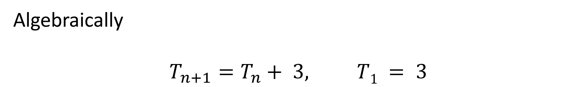
Concept Development
{3, 6, 9, 12, … , 21, 24, …}
start with the number 3 and add three, continue with this process
Algebraically
$$T_{n+1}=T_{n}+ 3, T1 = 3$$

Slide 7

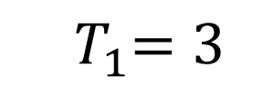
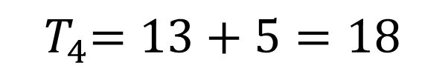
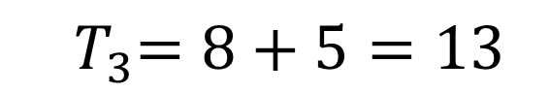
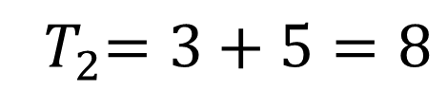
Use the recurrence relation to find the first four terms of the sequence $${ T}_{1}=3 , T_{n}=T_{n−1}+5$$
Guided Practice
$${ T}_{1}=3$$
$${ T}_{2}=3+5=8$$
$${ T}_{3}=8+5=13$$
$${ T}_{4}=13+5=18$$
First four terms are $3,8,13,18$

Slide 8
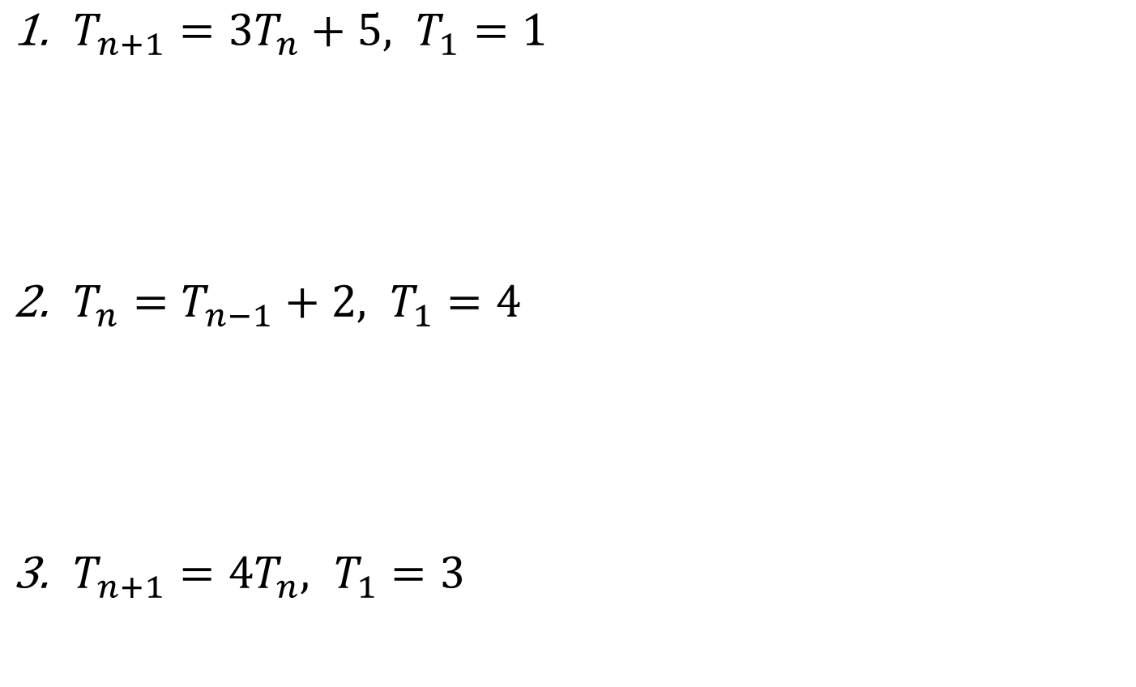
Explain in words, the recursive procedure given by the following rules
Guided Practice
$T_{n+1}={3T}_{n}+5, T_{1}=1$
$T_{n}=T_{n−1}+2, T_{1}=4$
$T_{n+1}={4T}_{n}, T_{1}=3$
Start with the number 1, multiply by 3 and add 5. The process continues.
Start with the number 4, add 2 to the number. The process continues.
Start with the number 3 and multiply 4 to the number. The process continues.

Slide 9
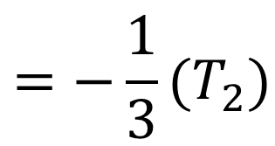
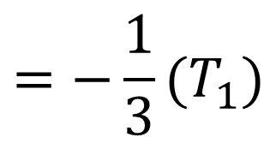
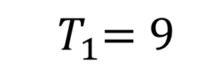

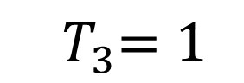
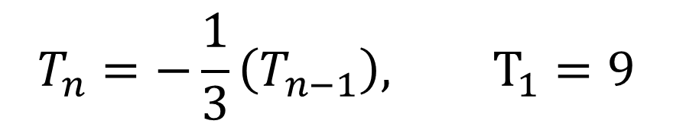
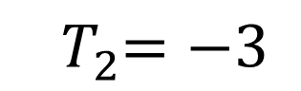
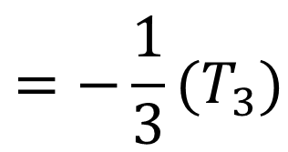
Find the recurrence relation for the following sequence: $$9, −3, 1, −\frac{1}{3}, …$$
Guided Practice
$${ T}_{1}=9$$
$$=−\frac{1}{3}(T_{1})$$
$${ T}_{2}=−3$$
$$=−\frac{1}{3}(T_{2})$$
$${ T}_{3}=1$$
$${ T}_{4}=−\frac{1}{3}$$
$$=−\frac{1}{3}(T_{3})$$
$$T_{n}=−\frac{1}{3}\left(T_{n−1}\right), T_{1}=9$$

Slide 10
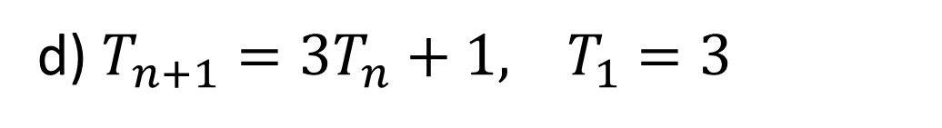

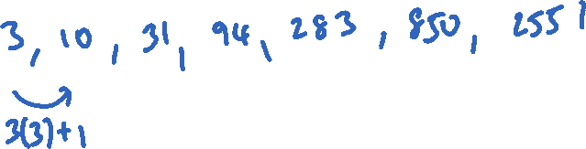
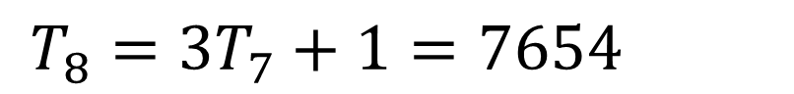
Find the sequence: 3, 10, 31, 94, 283, 850, 2551, determine: a) $T_{3}$ b) $T_{5}$ c) $3T_{2}$ d) The recurrence relation, hence $T_{8}$
Guided Practice
a) 31
b) 283
c) 3(10)=30
d) $T_{n+1}={3T}_{n}+1, { T}_{1}=3$
$T_{8}={3T}_{7}+1=7654$

Slide 11
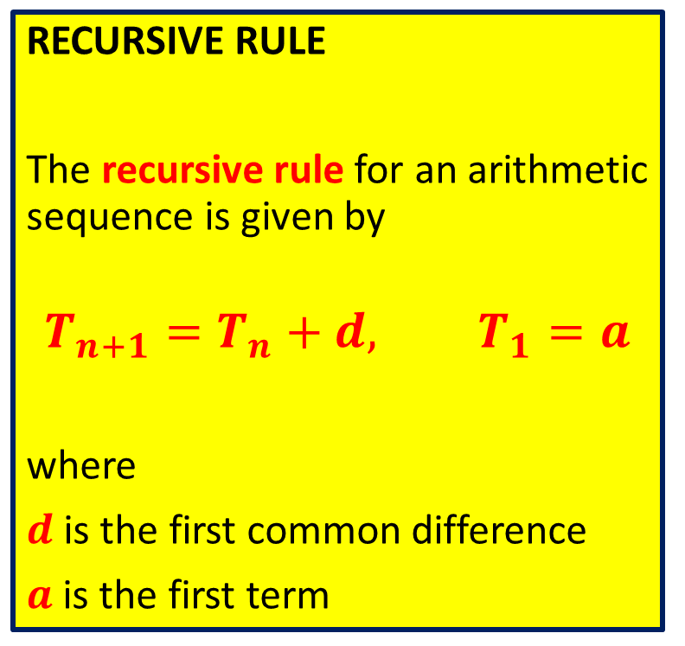
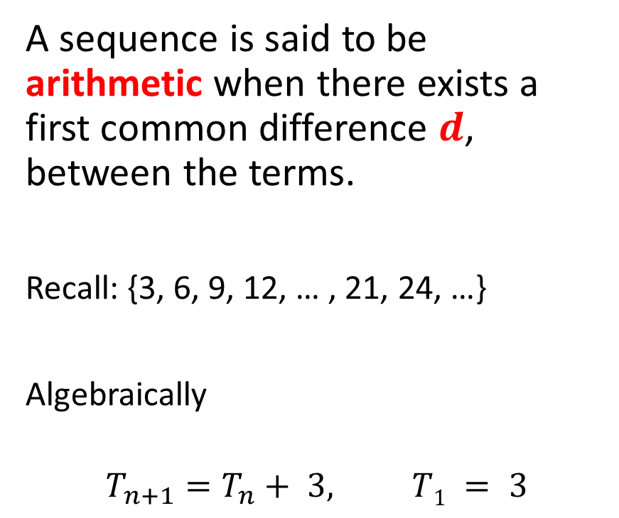
Arithmetic Sequence
Concept Development
RECURSIVE RULE
The recursive rule for an arithmetic sequence is given by
$$T_{n+1}=T_{n}+d, T_{1}=a$$
where
$d$ is the first common difference
$a$ is the first term
A sequence is said to be arithmetic when there exists a first common difference 𝒅, between the terms.
Recall: {3, 6, 9, 12, … , 21, 24, …}
Algebraically
$$T_{n+1}=T_{n}+ 3, T1 = 3$$

Slide 12
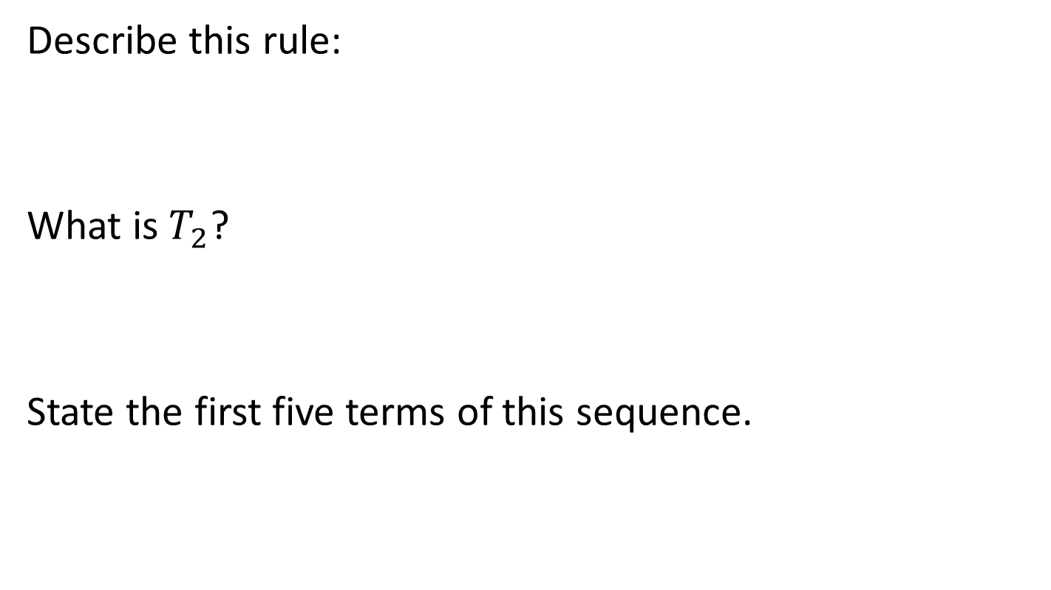

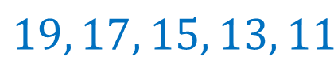

Consider: $T_{n+1}=T_{n}−2, T1 =19$
Skill Development
Describe this rule:
What is $T_{2}$?
State the first five terms of this sequence.
Start with the number 19, and subtract by 2. The process continues.
19 is the first term. -2 is the common difference.
$$T_{2}=T_{1}−2=19−2=17$$
$$19, 17, 15, 13, 11$$

Slide 13
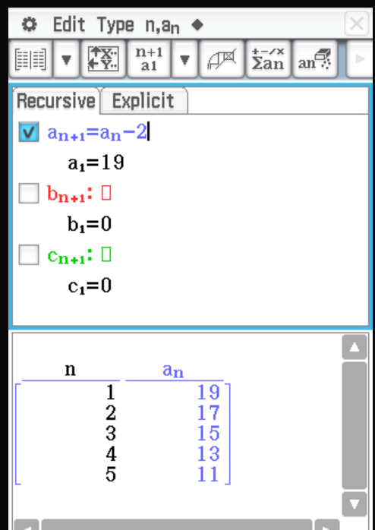
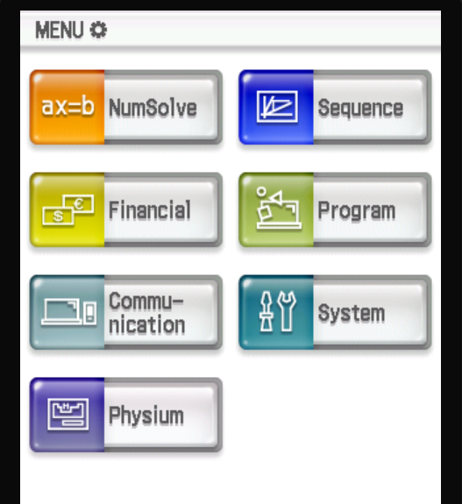
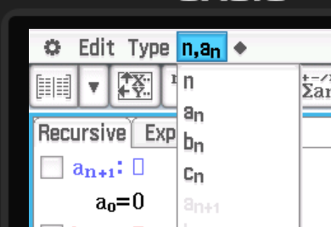
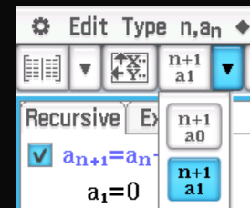
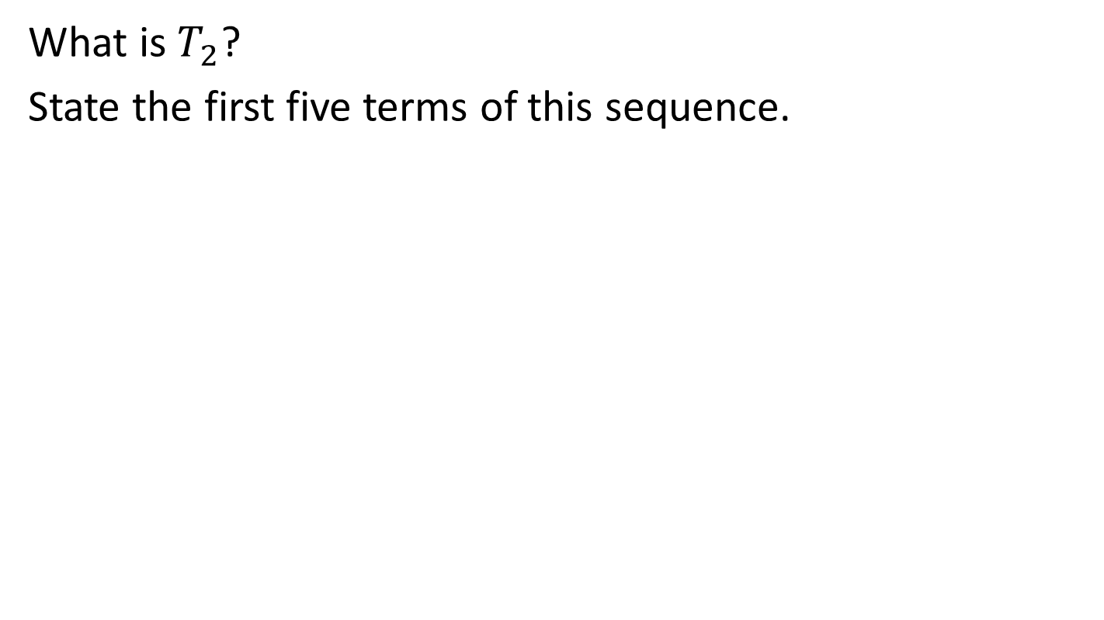
Consider: $T_{n+1}=T_{n}−2, T1 =19$
ClassPad
What is $T_{2}$?
State the first five terms of this sequence.

Slide 14
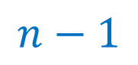

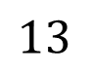
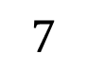

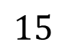
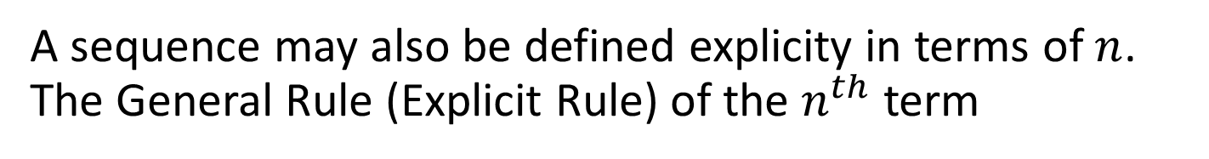
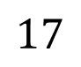
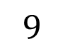


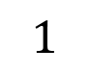

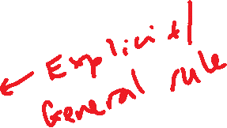
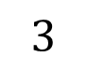

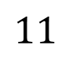
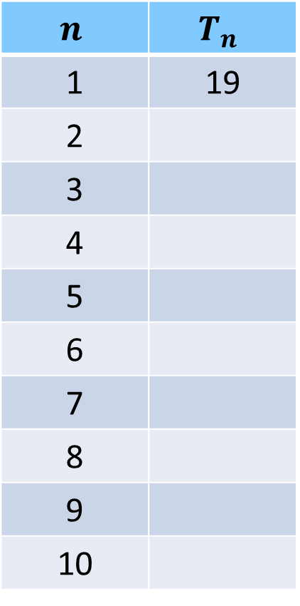

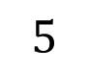
A sequence may also be defined explicity in terms of $n$. The General Rule (Explicit Rule) of the $n^{th}$ term
Skill Development
Consider $T_{n+1}=T_{n}−2, T1 =19$
$$n$$ | $$T_{n}$$
1 | 19
2
3
4
5
6
7
8
9
10
$$2$$
When we jumped to the 3rd term, two is subtracted ____ times.
When we jumped to the 5th term, two is subtracted ____ times.
When we jumped to the 10th term, two is subtracted ____ times.
When we jumped to the n^{th} term, two is subtracted ____ times.
So, the general rule is:
$$4$$
$$17$$
$$9$$
$$15$$
$$n−1$$
$$13$$
$$11$$
$$9$$
$$T_{n}=T_{1}−2\left(n−1\right)$$
$$7$$
$$5$$
$$T_{n}=19−2n+2$$
$$3$$
$$T_{n}=21−2n$$
$$1$$

Slide 15
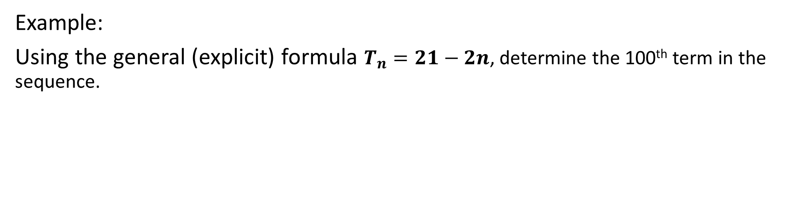
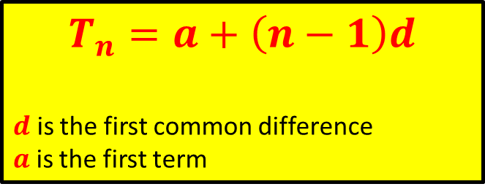
The General Rule (Explicit Rule) of the $n^{th}$ term for an arithmetic sequence
Skill Development
$$T_{n}=a+\left(n−1\right)d$$
$d$ is the first common difference
$a$ is the first term
Example:
Using the general (explicit) formula $T_{n}=21−2n$, determine the 100th term in the sequence.
$$T_{100}=21−2\left(100\right)=−179$$

Slide 16



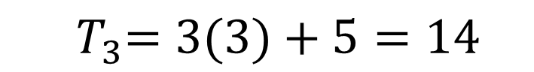
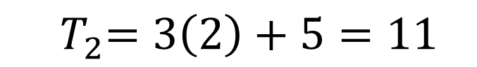
Use the recurrence relation to find the first four terms of the sequence $$T_{n}=3n+5$$
Guided Practice
$${ T}_{1}=3\left(1\right)+5=8$$
$${ T}_{2}=3\left(2\right)+5=11$$
$${ T}_{3}=3(3)+5=14$$
$${ T}_{4}=3(4)+5=17$$
First four terms are $8,11,14, 17$

Slide 17





Find the explicit rule for the $nth$ term of the sequence 1, 4, 9, 16 in terms of $n$
Guided Practice
$${ T}_{1}=1=1^{2}$$
$${ T}_{2}=4=2^{2}$$
$${ T}_{3}=9=3^{2}$$
$${ T}_{4}=16=4^{2}$$
$$∴T_{n}=n^{2}$$

Slide 18
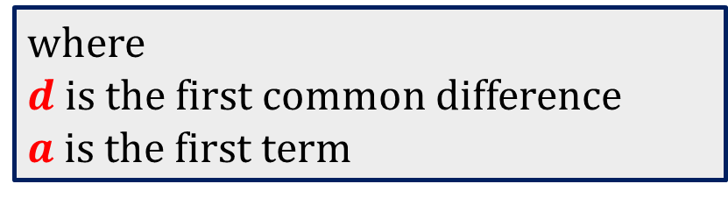
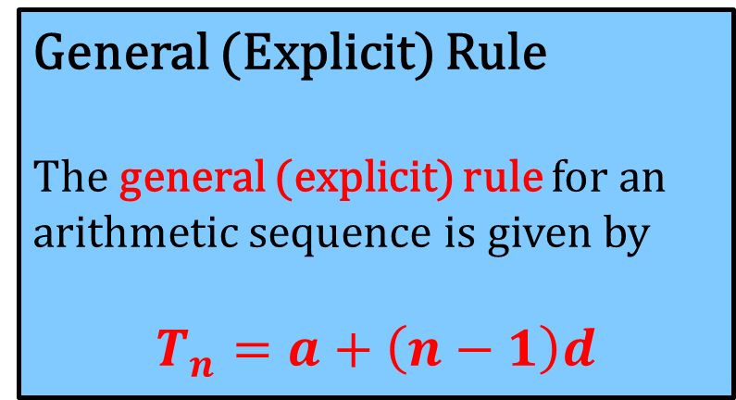
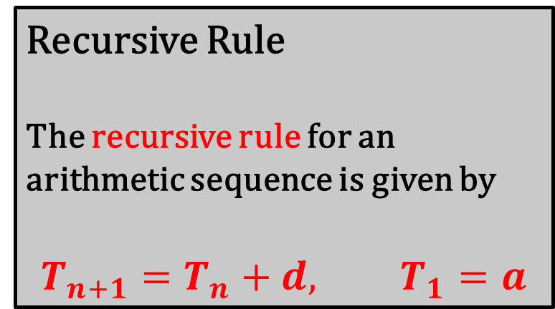
Concept Development
Recursive Rule
The recursive rule for an arithmetic sequence is given by
$$T_{n+1}=T_{n}+d, T_{1}=a$$
General (Explicit) Rule
The general (explicit) rule for an arithmetic sequence is given by
$$T_{n}=a+\left(n−1\right)d$$
where
$d$ is the first common difference
$a$ is the first term

Slide 19



For each of the following sequences, find the recurrence relation: a) 1, 2, 4, 8, … b) 3, -6, 12, -24, … c) 4, 9, 14, 19, …
Guided Practice
a) 1, 2, 4, 8, …
c) 4, 9, 14, 19, …
$$T_{n+1}=2T_{n},{ T}_{1}=1,$$
$$T_{n+1}=T_{n}+5,{ T}_{1}=4$$
b) 3, -6, 12, -24, …
$$T_{n+1}=−2T_{n},{ T}_{1}=3,$$

Slide 20






For each of the following sequences, find the explicit rule: a) 1, 2, 4, 8, … b) 3, -6, 12, -24, … c) 4, 9, 14, 19, …
Guided Practice
a) 1, 2, 4, 8, …
c) 4, 9, 14, 19, …
$$T_{n+1}=2T_{n},{ T}_{1}=1,$$
$$T_{n+1}=T_{n}+5,{ T}_{1}=4$$
$$T_{n}=1∙2^{n−1}=2^{n−1}$$
$$T_{n}=4+5\left(n−1\right)=5n−1$$
b) 3, -6, 12, -24, …
$$T_{n+1}=−2T_{n},{ T}_{1}=3,$$
$$T_{n}=3(−{2) }^{n−1}$$

Slide 21


Use a calculator to general the first 10 terms of the sequence of numbers defined by the rule $T_{n}=3+4n$
Guided Practice

Slide 22







At a particular school, the number of students studying Mathematical Methods increases each year. There are presently 40 students studying Methods. a) Set up a recurrence relation if the number is increasing by five students each year. b) Write down an explicit rule for the recurrence relation found in part a c) Find the number of students expected to be studying Methods in 5 years time.
Guided Practice
a) $T_{1}=40$
c) $T_{6}=40+5\left(6−1\right)=65$
$$T_{n+1}=T_{n}+5, T_{1}=40$$
b) $T_{1}=40$
$T_{2}=45= 40+5$
$T_{3}=50= 40+5(2)$
$T_{4}=55= 40+5(3)$
$T_{n}=40+5\left(n−1\right)=35+5n$

Slide 23





The height of a sand dune is increasing by 10% each year. It is currently 4m high. a) Set up a recurrence relation that describes the height of the sand dune. b) Write down an explicit rule for the recurrence relation found in part a c) Find the height of the sand dune 7 years from now.
Guided Practice
a) $T_{1}=4$
$$T_{n+1}=1.1T_{n}, T_{1}=4$$
b) $T_{1}=4$
$T_{2}=4.4=4×1.1$
$T_{3}=4.84=4×1.1×1.1=4×{\left(1.1\right)}^{2}$
$T_{n }=4×{\left(1.1\right)}^{n−1}$
c) $T_{8}=4.4×{\left(1.1\right)}^{7}=7.795m$

Slide 24

If $S_{n}=an^{2}+bn$, determine $S_{n+1}−S_{n}$
Guided Practice
$$S_{n+1}−S_{n}=a{\left(n+1\right)}^{2}+b\left(n+1\right)−an^{2}−bn$$
$$=a\left(n^{2}+2n+1\right)+bn+b−an^{2}−bn$$
$$=2an+a+b$$

Slide 25


The Fibonacci sequence is defined by $t_{1}=1, t_{2}=1, t_{n+2}=t_{n+1}+t_{n}$. Show that $t_{n+2}=2t_{n}+t_{n−1}$.
Guided Practice
$$t_{n+2}=t_{n+1}+t_{n}$$
$$∴t_{n+1}=t_{n}+t_{n−1}$$
$$t_{n+2}=t_{n}+t_{n−1}+t_{n}$$
$$={2t}_{n}+t_{n−1}$$

Slide 26
Independent Practice
Complete Cambridge Ex 15A

